Slide 1
Netflix
Data analysis
-Misba Ansari
-Shakeb patel

Slide 2
Agenda
Introduction
Methodology
Insights & Findings
Conclusion & Next Steps

Slide 3
Introduction
The Netflix Data Analysis project aims to uncover trends and insights from a dataset of movies available on Netflix.
The analysis focuses on metrics such as average rating, total votes, genres,& country and diversity
By leveraging visualization tools, this project helps identify popular genres, user preferences, and content trends across years.
The ultimate goal is to provide actionable insights that can guide Netflix's content strategy and enhance user engagement.

Slide 4
methodology
Netflix Data Analysis project was carried out using a systematic and structured approach:
Data Cleaning in Python & EDA
Connecting Python to SQL
Database Management in MySQL
Connecting MySQL to Power BI
Creating Visualizations in Power BI

Slide 5
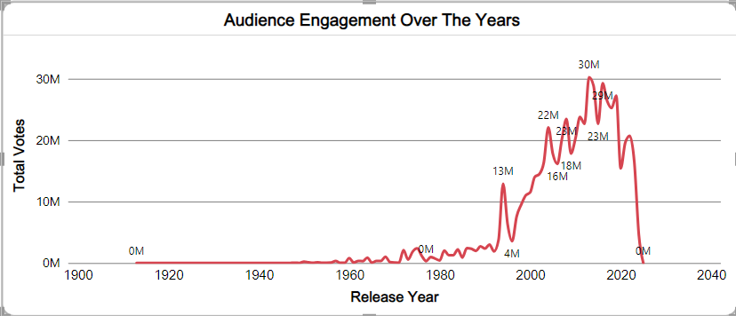
Insights and findings
Audience engagement peaking around 2015-2020 with over 4.8M votes.
the advent of streaming and increased global audience interest.

Slide 6
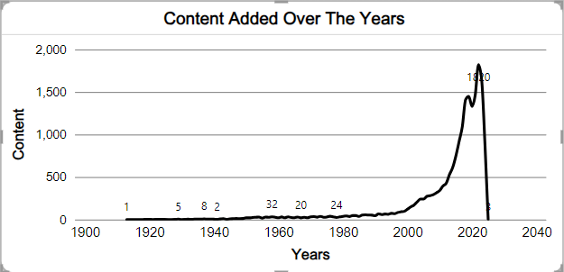
Insights and findings
The peak at 2020 indicates a significant burst of content creation, possibly linked to digital adoption or technological advancements.
The sharp decline post-2020 suggests an abrupt halt, which could be due to data collection gaps, policy changes, or external disruptions.
Growth correlates with internet and digital innovation

Slide 7
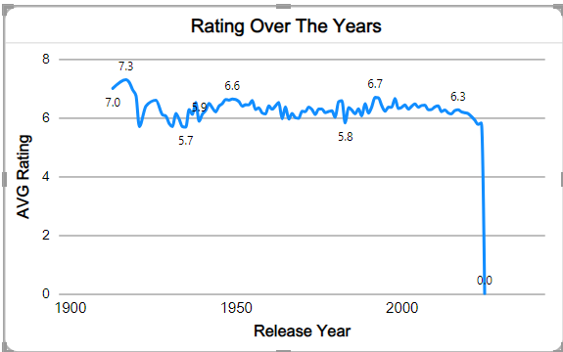
Insights and findings
Ratings peaked around the 1980s with an average close to 8.8
A Steady decline is observed from the late 1990s to the present, with recent years averaging below 7.0.

Slide 8
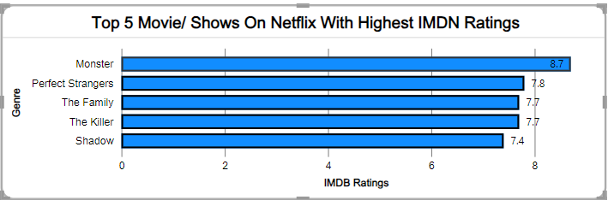
Insights and findings
Monster is the highest-rated movie/show with an IMDB score of 8.7
Perfect Strangers, The Family, and The Killer are closely ranked, with scores of 7.8 and 7.7 respectively
Shadow" is the lowest among the top 5 but still has a solid rating of 7.4.

Slide 9
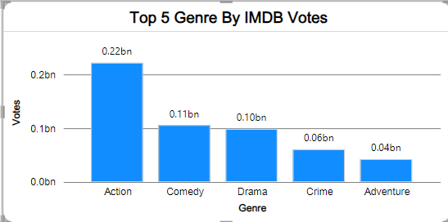
Insights and findings
Action leads by a significant margin with 0.22 billion votes, showcasing its popularity
Comedy and Drama follow with 0.11 billion and 0.10 billion votes respectively
Crime and Adventure genres have lower audience engagement, with 0.06 billion and 0.04 billion votes..

Slide 10
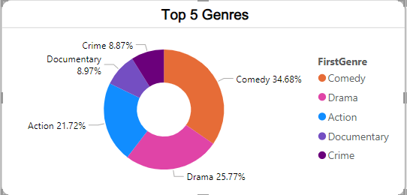
Insights and findings
Comedy dominates the genre distribution, accounting for 34.68% of the total.
Drama follows with 25.77%, while Action holds 21.72%.
Documentary and Crime represent smaller proportions, around 8.97% and 8.87% respectively.
Seek feedback
Reflect on performance
Explore new techniques
Set personal goals
Iterate and adapt

Slide 11
Conclusion & next steps
Netflix's most popular genres are Drama, Animation, and Comedy, driving user engagement and high ratings.
A significant percentage of Netflix’s library consists of high-rated content (IMDB > 7), showcasing its focus on quality
Netflix's global reach is vast, but content distribution varies across regions.
The platform's content quality and quantity have steadily grown over the years.
NEXT STEPS
Content Strategy - Focus on top-performing genres and improve global distribution.
Expand Analysis- Include user behavior (e.g., watch patterns) and competitor data
Future Work- Add predictive analytics to forecast high-performing genres and content trends.

Slide 12
THANK YOU
Misba Ansari
Shakeb Patel

